Slide 1
COMPANY PATH NAME
Windows Application Software Providing worlds best Pathology Management or Laboratory Management software.

Slide 3
Dashboard
We are amongst the well-regarded entity in the market by offering Laboratory Management Software to our esteemed clientele. We render this service in accordance to our client’s terms and within certain time frame. Owing to flexibility and consistency, these are enormously well-liked in the market.

Slide 4
COMPANY PATH NAME software
A fully optimized pathology lab software ease in use & understand with multi organization concept with its ability an lab can reduce its current working time on a patient by half and allows the pathology to manage patient and reports of patient with billing section and history of the patients. Allows the user to download the report from web at any point from anywhere

Slide 5
Modules
Home
Profile
Registration
Registration
Advance Appointment
Operations
Group Setting
Sub-Group Setting
Department Setting
Lab Test Setting
Designation Setting
Specimen Setting
Bill Setting
Collection Boy Setting
Unit Setting
Comment Setting
Report
Report Collection Boy Wise
Report Doctor Wise
Report Contact Wise
Rate List
Report Test Wise
Security
Employee
User and Permission
Database Backup
Password Setting

Slide 6
Registration
Patient Registration
Create Patient Registration with details of the patient as Name, father name, phone number, email, address, collection boy.
List of test for assigning tests to the patient screen for billing of test.
Pending Report Screen to show the patients pending reports to be filled by the operator with details of results of test conducted by the lab and to verify the filled report by doctor.
Complete report screen showing reports complete reports filled by the operator verified & signed by the doctor that all test result are correct.
Patient Search section to search registered by different criteria on basis of name, collection boy, mobile number and date with option to edit and delete a registered patient

Slide 7
Advance Appointment
Advance appointment screen to create an appointment of patient. Showing todays appointment and all appointments with option to Edit, Register the appointment as patient registration and delete an appointment

Slide 8
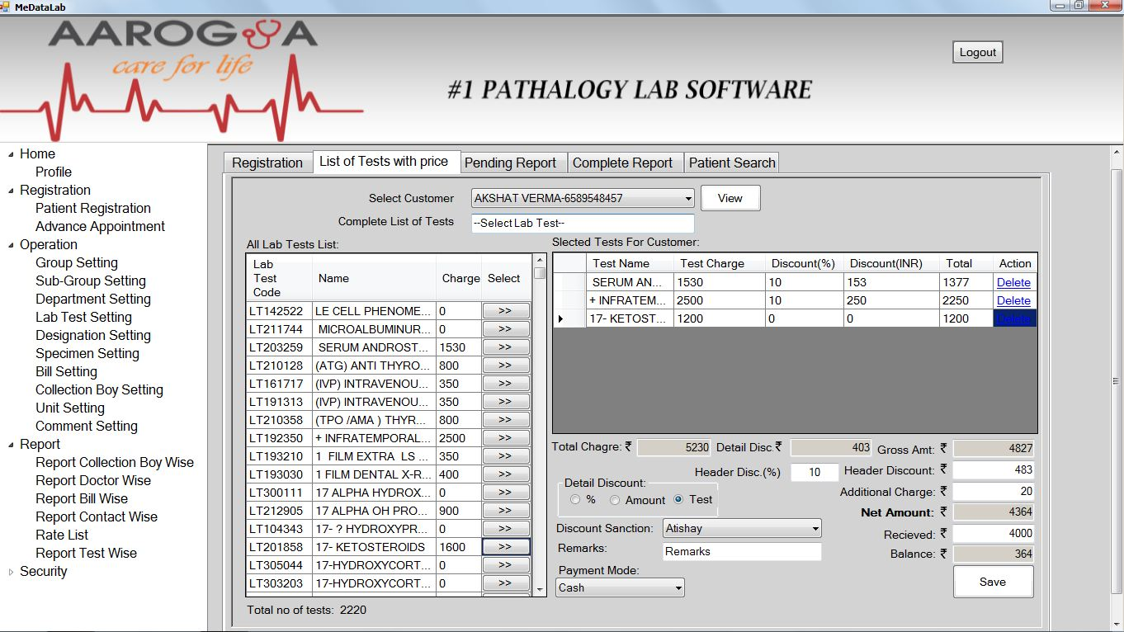

Slide 9
Operation
Group setting to create group of lab test
Sub group setting for creation of sub group of lab test and assigning it under a group
Lab test setting creating a lab test to fill the details of the lab test with description of test, measurement, technique group & sub group with test price.
Different profile creation of a lab test with details of profile as range of test and comment of the lab test with unit select for the test. Mapping of test screen to map test under a different test with option to edit & delete in every section.
Bill setting screen for settlements of pending bills.
Specimen, designation, Collection boy setting, unit setting and comment setting for creation of the following with edit & delete.

Slide 10
Reports
Report Collection boy wise
Detail report showing all the patient registered under the selected collection boy.
Report Doctor Wise
Detail report of doctor showing all the patient registered report verified by doctor.
Report Bill Wise
Details Report of patients with the bill amounts.
Report Contact Wise
Details of patients Registered in the lab
Rate List
Showing Detail pricing of Lab test
Report Test wise
Report Showing the test used in labs with count of number of times assigned to patients

Slide 11
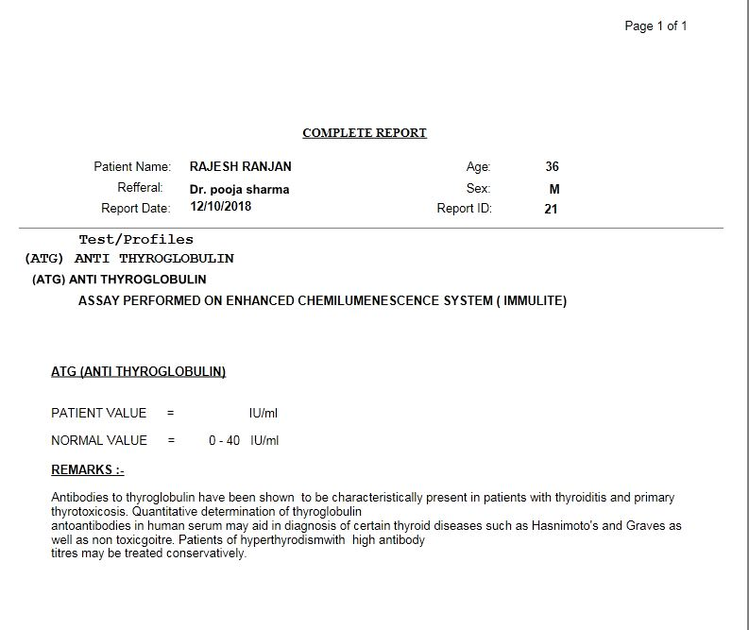
Final report of lab test

Slide 12
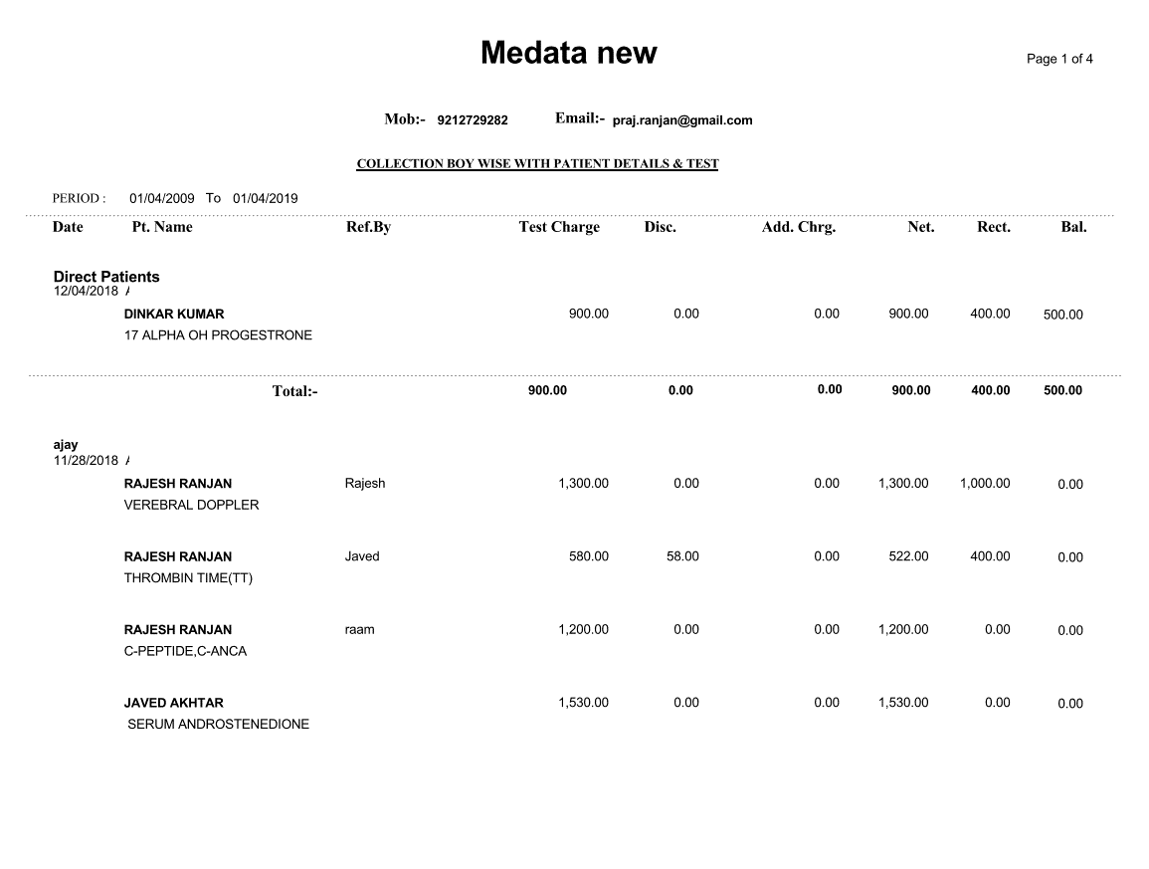
Collection boy wise report

Slide 13
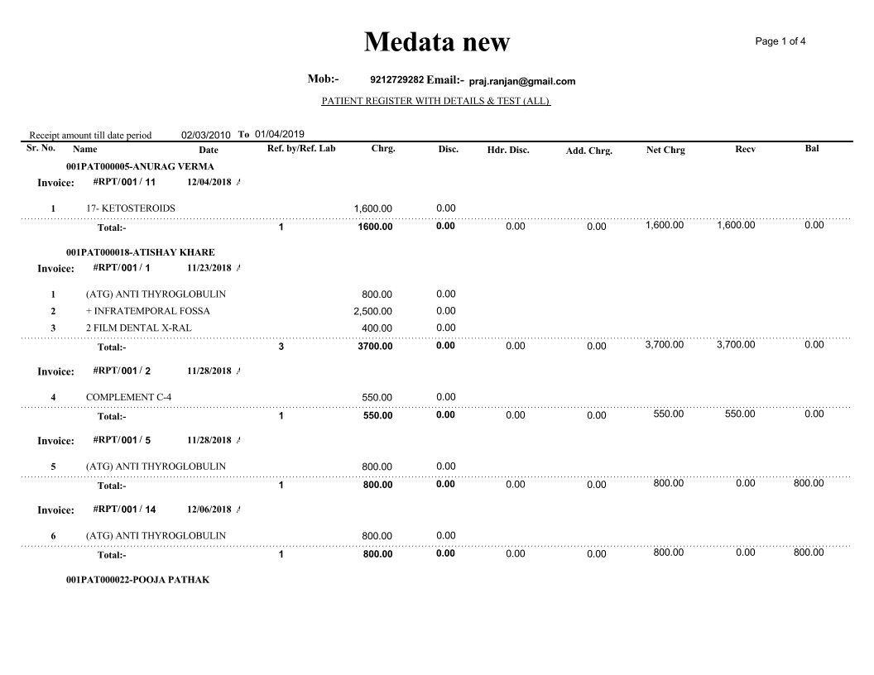
Collection boy wise report

Slide 14
Security section
Employee Section
Employee section for creation of employee of lab example operator, doctor etc. with login username and password with employee code.
User and permission
Assigning permission to users for particular module with details permission to view edit or delete in the particular sections
Database Backup
Particular section allows to take complete current database backup for security and backup
Password setting
Allows to change the password of a employee.

Slide 15
Benefits of Pathology MS:
Reduced costs and improved efficiency Overall Patients Data Management. Referral Commission Reporting. Easy Information Sharing. Flexible Reporting System. A Centralized Patients record system. Accessible with Doctors & other Staff Members. Flexibility to accommodate new requirements Improved quality and compliance.

